Slide 1

Remote Antenna Training

Slide 2

Topics
Hardware differences between Remote Antenna 1.0 and Remote Antenna 2.0
Mounting options
Supported Access Points
Connecting Remote Antenna 2.0 to SMART HOPPING® 1.0 Access Point.
LED indicator on Remote Antenna 2.0

Slide 3
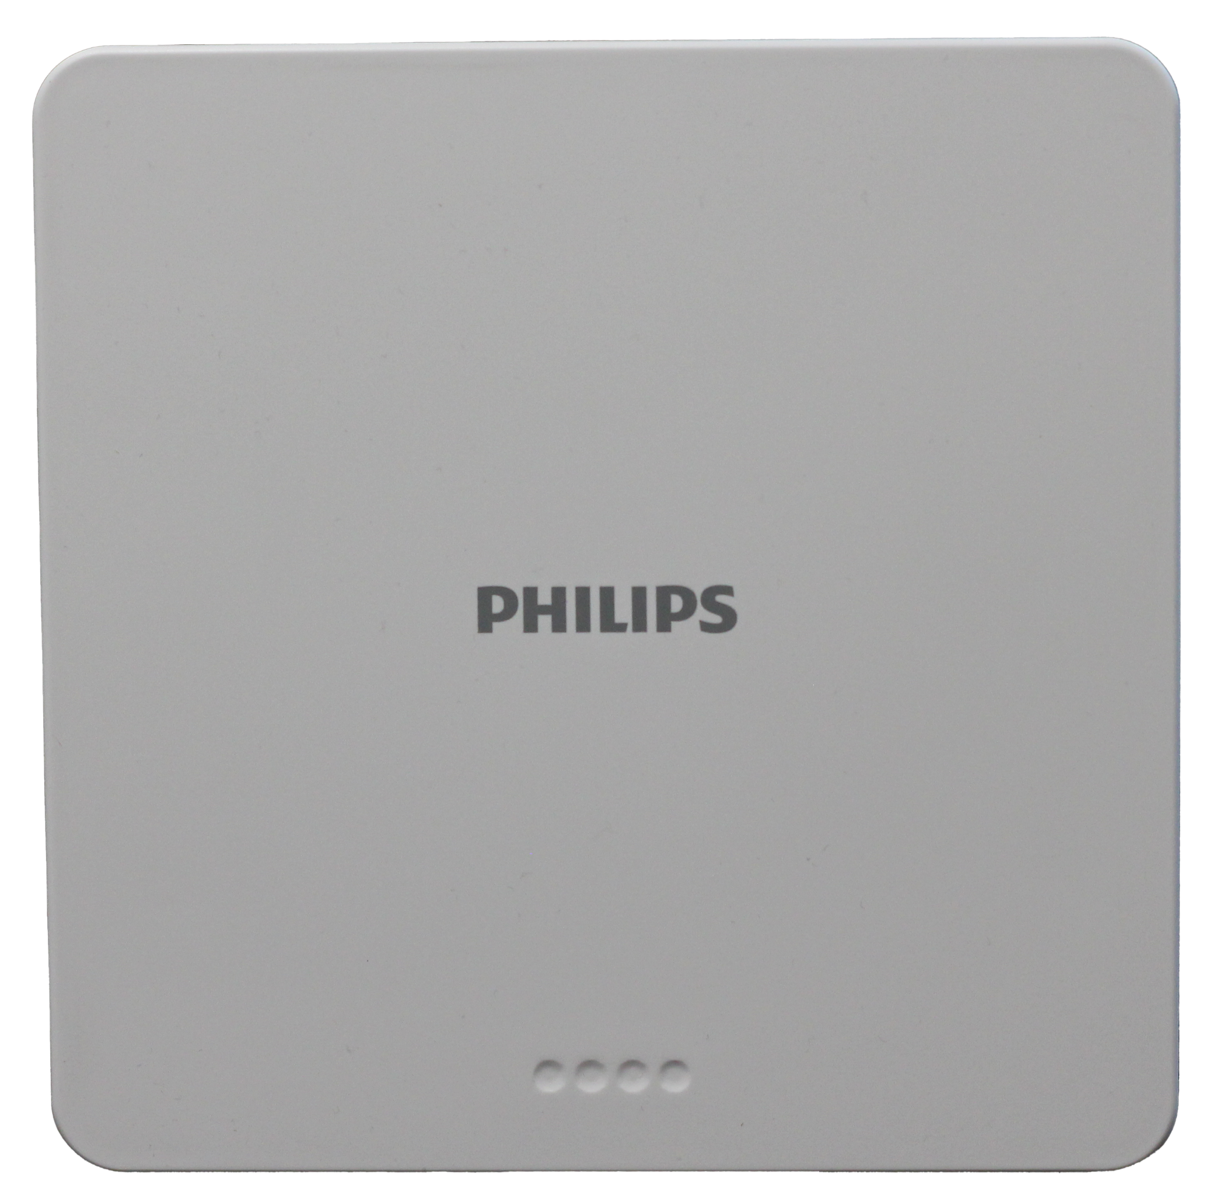
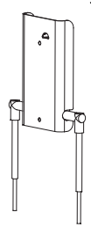
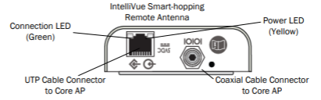
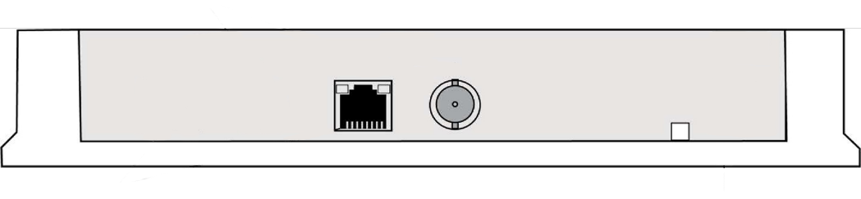
Hardware differences
Remote Antenna SMART HOPPING® 1.0
Remote Antenna SMART HOPPING® 2.0
Connection LED
(Green)
Power LED
(Orange)
UTP cable connectors to AP
BNC coaxcial cable connector to AP

Slide 4
LED Indicator on Remote Antenna 2.0
The Remote Antenna 2.0 have 4 LED indicators read from left to right.
Note: Power/Sync – Network – Radio is not printed on the physical product.
LED1 Power/Sync | LED2 Network | LED3 Radio | LED4 | Status
Off | Off | Off | Off | No power, check connection to AP. Note: Remote Antenna receives power from the Access Point. When the SMART HOPPING® 2.0 system ‘Mute LED’ setting is enabled, the LEDs will turn off 120 sec after entering normal operation.
Red | Off | Off | Off | Default state by hardware during power up. Red until ‘Power On’ state.
Amber | Off | Off | Off | Power On
Amber | Green | Off | Off | Operational
Flashing Red | Off | Off | Off | Error detected
LED 1
LED 2

Slide 5
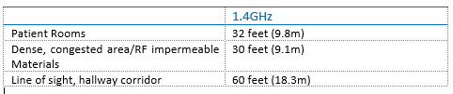
Coverage Area
The Remote Antenna 2.0 have the same coverage as the Remote Antenna 1.0
Recomendations:
NOTE: When working with Remote Antennas, the special cable is 68 feet (20.7m) long.

Slide 6
Mounting options
When installing the Remote Antenna there are some things that you need to take into account, before doing the physical installation.
Consider building construction when placing the Remote Antenna to account for interference from ceramic wall tile, lead lined walls, elevator shafts, reinforced windows, and other obstacles which may cause signal degradation.
Place the Remote Antenna in locations where there is no more than one wall between the Remote Antenna and the coverage area.
Ensure that the coverage area considers bathrooms, hallways, and windows.
Remote Antenna (internal) must be more than 4 inches (10 cm) away from metal structures. If the antennas are too close to the structure, antenna performance can be degraded.
Access Points or Remote Antennas shall not be placed closer than three feet (1 m) from other Access Points or Remote Antennas to prevent signal overload conditions.
The coaxial cable bundle cable length may vary from 69-79 feet. When planning Remote Antenna placement, ensure the maximum length between the Access Points and the Remote Antenna is 69 feet.
Try to avoid placing Remote Antenna close to other electrical devices (exit lights, light fixtures, speakers, etc.). Devices, such as florescent light ballasts, can create a significant amount of interference that can impact system performance.
More details about the physical installation can be found in SMART HOPPING 2.0 Remote Antenna 1.4GHz Installation guide.

Slide 7
Supported Access Points
The RTX3466 Remote Antenna is compatible with all SMART HOPPING® 1G4 Access Points.
When connecting the Remote Antenna to a SMART HOPPING® 1.0 Access Point, the Remote Antenna will seamlessly adapt to align with the features of the SMART HOPPING® 1.0 Access Point.

Slide 8
Connecting Remote Antenna 2.0 to SMART HOPPING® 1.0 Access Point
When connecting Remote Antenna 2.0 to a SMART HOPPING® 1.0 Access Point there are some things that you need to be aware of.
Unlike SMART HOPPING® 1.0 Remote Antenna, the SMART HOPPING® 2.0 have LED’s on the front ,that indicate the state of the Remote Antenna.
Upon power on/start up, the SMART HOPPING® Access Point performs a POST (Power-On Self Test) to ensure that its basic components are fully functional. This test detects critical system failures.
Remote Antenna 2.0:
As the test progresses, the state of the system is displayed through a series of color combinations on the power/sync, and network LEDs on the front of the Remote Antenna.

Slide 9
Connecting Remote Antenna 2.0 to SMART HOPPING® 1.0 Access Point
SH1.0 Access Point:
Also on the SH1.0 Access Point LED’s will indicate the state of the Remote Antenna.
In the last phase of boot up the SH 1.0 Access Point Power/Sync , Network and Radio LED is initially all red and then Power/Sync turns steady green and Network flash green.
When the Remote Antenna is fully operational the Power/sync LED will light Amber and network LED will be green.
If SH1.0 Access Point detects an error on the Remote Antenna, it will cut of the connection, both under startup and normal operation.
In case the Remote Antenna fails, the Access Point will continue to operate as normal.
Note. If after connecting and powering the Access Point, its LEDs are lit red and the Remote Antenna LEDs do not light at all, open the APC web interface, click System in the View Device tree, click Configure and then select the Advanced tab. Verify that the Allow new Access Points to be added automatically option is set to True. This option must be set to True for the Access Point and Remote Antenna LEDs to light properly.

Slide 10
Test and Inspection Procedures
Before Installation:
Remote Antenna Visual Inspection:
Inspect all components, the Remote Antenna, cables, connectors. Check for signs of abration wear and other damages, before installation.
After installation:
Remote Antenna Power-On:
Check the LED’s on the front of the Remote Antenna that Power/sync LED is ”Amber” and the Network LED is ”green”.
Check status on APC:
Check that RA's are connected on APC; go to the Basic Status of the Access Point that the Remote Antenna is connected to and observe the 'Remote Antenna Status' and verify that Remote Antenna connection is 'OK'

Slide 11
Thank you for your attention
RTX A/S
Stroemmen 6
9400 Noerresundby
Denmark
www.rtx.dk

